Slide 1
Objects & Classes

Slide 2
Syllabus
Classes
Instance variables
Methods
Constructors
Access Specifiers
Abstract Classes and Wrapper Classes
Autoboxing and Unboxing
Inheritance, Polymorphism, Method Overriding
Use of Static
final, super and this keyword
String and mutable string

Slide 3
Class and Object
Class is a collection of variables and methods where as variable defines a state and method defines behavior of an object.
It is a blue print of an object
It is used to construct the object
Dog
Size
Age
Breed
Knows
Bark()
Does
public void bark(){
if(age <= 2)
System.out.println("Chiiii.......Chiiiii");
else if (age <= 5)
System.out.println("Rufff.......Rufff");
else
System.out.println("Bhoooo.......Bhoooo");
}

Slide 4
Class and Object continue……
Employee
Account
Name
Designation
Emp_id
DOJ
Acct_id
Acct_type
Balance
Knows
Knows
getPayband()
getExperience()
checkBalance()
Does
Does
public void checkBalance(){
if(acct_type.equals("saving") && balance <= 500)
System.out.println("You do not have suffiecient balance!!!");
else
System.out.println("You have suffiecient balance!!! you can withdraw");
}
public String getPayband(){
if(designation.equals("director"))
return "37100 -- 65000";
else if(designation.equals("Assistant professor"))
return "15600 -- 37100";
else
return "9200 --18300 ";
}

Slide 5

Class and Object continue……
Object is an instance of class
Emp Obj 1
Emp Obj 2
Emp Obj 3
Emp Obj 4

Slide 6
Object and memory allocation
Java allocates memory to an object dynamically
Object creation in java has three steps.
1
2
3
Create a reference
Create object
Assign object to a reference
Employee xyz
New Employee();
=

Slide 7
Object and memory allocation
Reference is allocated in stack and object in heap
Obj 1
Employee xyz = new Employee()
Name
designation
Employee abc = xyz;
Employee xyz = null;
xyz
Name
designation
xyz = new Employee();
abc
Heap
Obj 2
Stack

Slide 8
Constructor
Constructor is a special method with same name as it’s class name
No return type for constructor. Not even void
Constructors are implicitly called when objects are created
A constructor without input parameter is default constructor
Constructor can be overloaded

Slide 9
Class Date: Constructors
class Date {
  int dd, mm, yy;
  public Date(){
  dd = mm = yy = 0;
  }
  public Date(int d, int m, int y){
    dd = d;
    mm = m;
    yy = y;
    }
  public void dispDate(){
  System.out.println(“Date is : “ + dd +”-”+ mm +”-”+ yy);
  }
public static void main(String args[ ])
{
Date d1;
d1 = new Date();
d1.dispDate();
Date d2 = new
Date(17,7,2017);
d2.dispDate();
}
}

Slide 10
Method overloading
Reusing the same name for a method.
Arguments (& possibly return type) should be different.
The method calls are resolved at compile time using the method signature.
Compile time error occurs if compiler can’t match the args or if more than one match is possible.
Notes:
A difference in return type alone is not sufficient to constitute an overload. It then becomes illegal.
The method calls are resolved at compile time using the method signature.

Slide 11
Java Modifiers
Modifier | Class | Class Variables | Methods | Method Variables
public
private
protected
default
final
abstract
strictfp
transient
synchronized
native
volatile
static
Modifier | Same Class | Same Package | Subclass (Different Package) | Other Packages
public | ✔ | ✔ | ✔ | ✔
protected | ✔ | ✔ | ✔ | ✘
default | ✔ | ✔ | ✘ | ✘
private | ✔ | ✘ | ✘ | ✘

Slide 12
Modifiers – Class
public
  Class can be accessed from any other class present in any package
default
  Class can be accessed only from within the same package. Classes outside the package in which the class is defined cannot access this class
final
  This class cannot be sub-classed, one cannot extend this class
abstract
  Class cannot be instantiated, need to sub-classs/extend.
strictfp
  Conforms that all methods in the class will conform to IEEE standard rules for floating points

Slide 13
Modifiers – Class Attributes
public
  Attribute can be accessed from any other class present in any package
private
  Attribute can be accessed from only within the class
protected
  Attribute can be accessed from all classes in the same package and sub-classes.
default
  Attribute can be accessed only from within the same package.
final
  This value of the attribute cannot be changed, can assign only 1 value
transient
  The attribute value cannot be serialized
volatile
  Thread always reconciles its own copy of attribute with master.
static
  Only one value of the attribute per class

Slide 14
  Modifiers – Methods
public
  Method can be accessed from any other class present in any package
private
  Method can be accessed from only within the class
protected
  Method can be accessed from all classes in the same package and sub-classes.
default
  Method can be accessed only from within the same package.
final
  The method cannot be overridden
abstract
  Only provides the method declaration
strictfp
  Method conforms to IEEE standard rules for floating points
synchronized
  Only one thread can access the method at a time
native
  Method is implemented in platform dependent language
static
  Cannot access only static members.

Slide 15
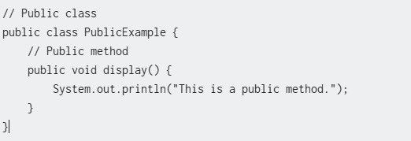
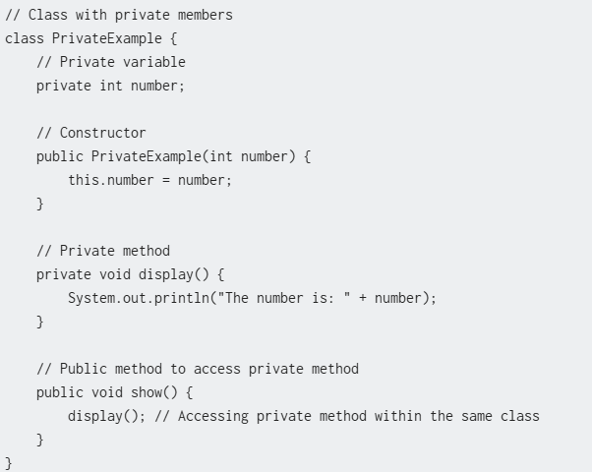
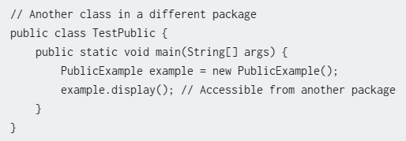
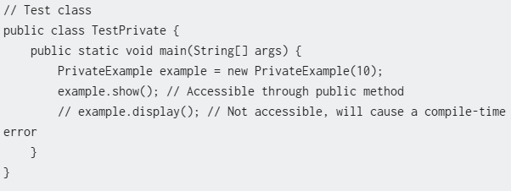
Public
Private

Slide 16
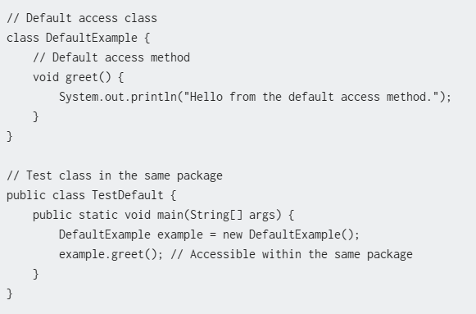
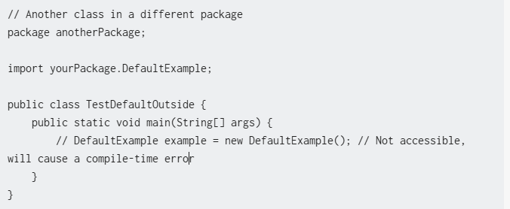
default

Slide 17
Exploring OOPS - Inheritance
Inherit properties of parent class in to child class
Inheritance is used when more specific version of a class is required
Inheritance represent by IS-A relationship
  Ex. Employee IS-A person
  Savingaccount IS-A Account
  Peon IS-A employee
  ETC

Slide 18

What is Inheritance
The ability of a class of objects to inherit the properties and
methods from another class, called its parent , base or super class.
The class that inherits the data members and methods is known as subclass or child class.
In Java, a class can only extend one parent.
No Multiple Inheritance In Java

Slide 19
Inheritance (Example)
Here ‘extends’ keyword,
signaling inheritance
Parent
Child
public class Person {
private String name;
public void setName(String name) {
this.name = name;
}
public String getName() {
return name;
}
}
public class Employee extends Person {
private String eid;
public void setEid(String eid) {
this.eid=eid;
}
public String getEid() {
return eid;
}
}

Slide 20
Inheritance (Continued)
Types of Inheritance
1. Single Level Inheritance
Derives a subclass from a single superclass.
Example
Class Person
Class Employee
Class Student

Slide 21
Inheritance (Continued)
Types of Inheritance (Continued)
2. Multilevel Inheritance
Inherits the properties of another subclass.
Example
Class Person
Class Employee
Class Regular

Slide 22
Inheritance
Inheritance
Inherit the features of the superclass
  public class Car //superclass
  {
  public int maxSpeed;
  public String color;
  public int getSafeSpeed() { return maxSpeed/2.5; }
  }
  public class Nissan extends Car //subclass
  {
  public boolean inteligentKey;
  }

Slide 23

No more Silly questions
Why do you need to write a constructor if the compiler Writes one for you?
If you need code to help initialize your object and get it ready for use, you'll have to write your own constructor. You might, for example, be dependent on input from the user before you can finish making the object ready.
Can you also have a method that's the same name as the class?
Java lets you declare a method with the same name as your class. That doesn't make it a constructor, though. The thing that separates a method from a constructor is the return type. Methods must have a return type, but constructors cannot have a return type.

Slide 24
No more Silly questions
Are constructors inherited If you don't provide a constructor but your superclass does, do you get the superclass constructor .
No. Constructors are not inherited.

Slide 25
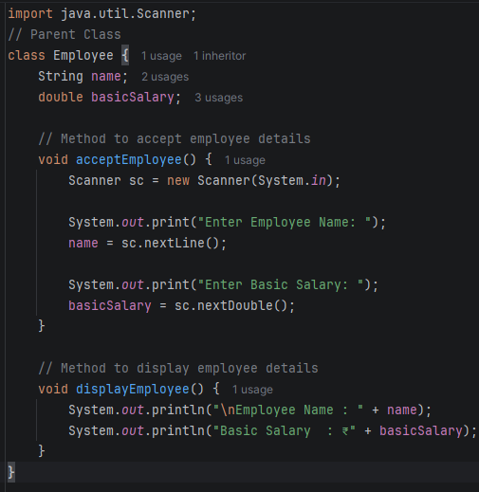
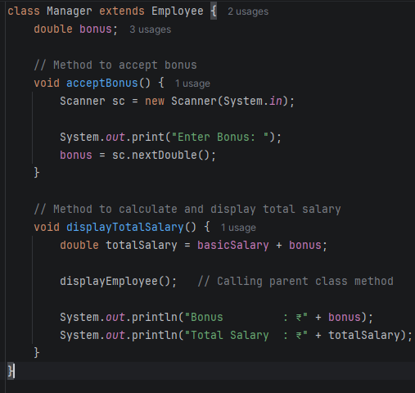
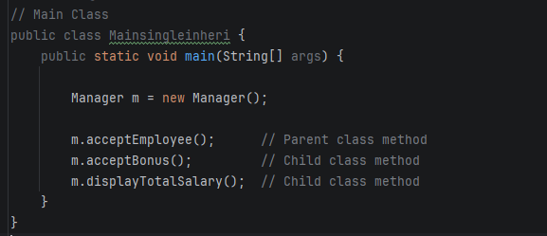
Create Single-Level Inheritance by creating an Employee class and a Manager class, where the Manager inherits the properties of Employee and calculates the total salary.

Slide 26
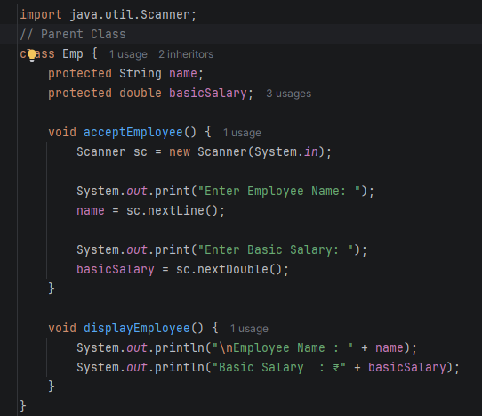
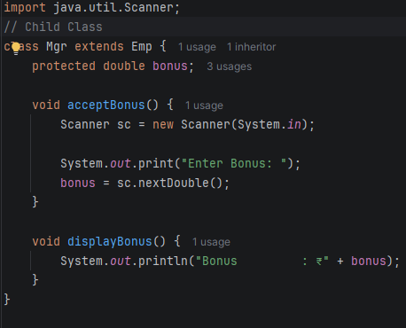
Employee Management System
Create a class Employee that stores the employee's name and basic salary.
Create a class Manager that inherits from Employee and stores the bonus.

Slide 27
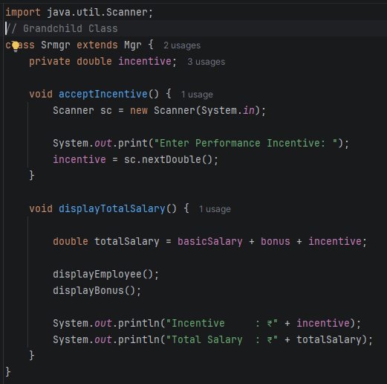
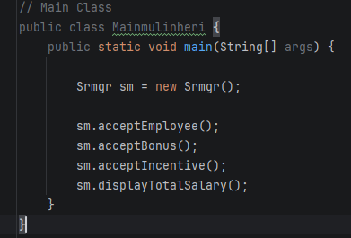
Create another class SeniorManager that inherits from Manager and stores the performance incentive.
Calculate and display the total salary.
Formula: Total Salary = Basic Salary + Bonus + Performance Incentive

Slide 28
Static
For static variable only one copy exists and it is shared by all objects.
These variable are called as class variables
It is same as global variable in c & c++
Static methods are invoked on behalf of entire class not on a specific object instantiated from that class.
Static methods only access static variable & static methods of a class
There is no this reference
It is invoked using class name
  e.g. Classname.MethodName();
Static method can also be invoked by object reference too

Slide 29
Terminology for Class Members
Instance Members
These are instance variables and instance methods of an object. They can only be accessed or invoked through an object reference
Instance Variable
A variable which is allocated when the class is instantiated. Ie when an object of the class is created.
Instance Method
A method which belongs to an instance of the class. Objects of the same class share its implementation.
Static Member
These are static variables and static method of a class. They can be accessed or invoked either using the class name or through an object reference.
Static Variable
A variable which is allocated when the class is loaded. It belongs to the class and not to any object of the class.
Static Method
A method which belongs to the class and not to any object of the class.

Slide 30
This
Every class member gets a hidden parameter the this reference.
this is a keyword in Java.
this points to the current object.
this always holds address of an object which is invoking the member function.
Refer to Current Class Instance Variable
Call Current Class Method
Constructor Chaining
class Student {
int id;
Student(int id) {
this.id = id; // this.id refers to instance variable
}
void display() {
System.out.println("ID = " + id);
}
public static void main(String args[]) {
Student s = new Student(101);
s.display();
}
}
class Demo {
void message() {
System.out.println("Hello");
}
void display() {
this.message();
}
public static void main(String args[]) {
Demo d = new Demo();
d.display();
}
}
class Student {
Student() {
this(101);
System.out.println("Default Constructor");
}
Student(int id) {
System.out.println("ID = " + id);
}
public static void main(String args[]) {
Student s = new Student();
}
}

Slide 31
OOPS Explored - Abstraction
Abstraction
  Hide certain details and show only essential details
  public abstract class Shape
  {
  String color;
  public abstract double getArea();
  }
Abstract class

Slide 32
Exploring OOPS - Polymorphism
  public abstract class Shape
  {
  public abstract int getArea();
  }
  public class Square extends Shape
  {
  public int getArea(int s) { return s*s; }
  public int getArea() { return getArea(1); }
  }
  public class Rectangle extends Shape
  {
  public int getArea(int length, int breadth) { return length * breadth; }
  public int getArea() { return getArea(1,1); }
  }

Slide 33
Exploring OOPS – Polymorphism continue….
  public class Shape
  {
  public void display() {
  System.out.println(“In Shape”);
  }
  }
  public class Square extends Shape
  {
  public void display() {
  System.out.println(“In Square”);
  }
  }
  Shape s1 = new Shape();
  s1.display();
  Square s2 = new Square ();
  s2.display();
  Shape s3 = new Square ();
  s3.display();
S3
s2
s1
square
shape

Slide 34

OOPS Explored - Encapsulation
I want to share my birthday gift only with my friends
I can share my puppy video with everyone
My YouTube videos
My YouTube videos
My YouTube videos
My Wedding
Gift
My Cute
puppy
My Wedding
Gift
My Cute
puppy
My Cute
cat
My Hawaii
trip

Slide 35
OOPS Explored - Encapsulation
Encapsulation
  Binding data and methods together
  public class Employee
  {
  private String empName;
  private int salary;
  public String getSalary(String role)
  {
  if(“Manager”.equals(role)) {
  return salary;
  }
  }
  public String setSalary(String role, int newSal)
  {
  if (“Admin”.equals(role)) {
  salary = newSal;
  }
  }
  }

Slide 36
How Child Comes before Parents
Constructor in inheritance
Person
Employee
Person
Employee
Employee inherited person class
Employee xyz = new Employee()
HEAP

Slide 37
Use of super keyword
Call Parent Class Constructor
class Animal {
Animal() {
System.out.println("Animal Constructor");
}
}
Example
class Dog extends Animal {
Dog() {
super();
System.out.println("Dog Constructor");
}
public static void main(String args[]) {
Dog d = new Dog();
}
}
Animal Constructor
Dog Constructor
Notes:
The nice thing about the Student constructor is that it doesn’t have to know exactly what the Person constructor does, it can just initialize its private members and then ask Person to do the same; it’s opaque.

Slide 38
Use of super keyword
To Access Parent Class Variable
class Animal {
String color = "White";
}
class Dog extends Animal {
String color = "Black";
void display() {
System.out.println("Dog Color = "
+ color);
System.out.println("Animal Color = "
+ super.color);
}
}
Example
public static void main(String args[]) {
Dog d = new Dog();
d.display();
}
Dog Color = Black
Animal Color = White
Notes:
The nice thing about the Student constructor is that it doesn’t have to know exactly what the Person constructor does, it can just initialize its private members and then ask Person to do the same; it’s opaque.

Slide 39
Use of super keyword
Allows you to access methods and properties of the parent class,
public class Person {
private String name;
public Person(String name) {
this.name = name;
}
public String getName() {
return name;
}
}
Example
public class Employee extends Person {
private String empID;
public Employee(String name) {
super(name); // Calls Person constructor
}
public void setID(String empID){
this.empID=empID;
}
public String getID(){
return empID;
}
}
Notes:
The nice thing about the Student constructor is that it doesn’t have to know exactly what the Person constructor does, it can just initialize its private members and then ask Person to do the same; it’s opaque.

Slide 40
Final Classes: A way for Preventing Classes being extended
Final
We can prevent an inheritance of classes by other classes by declaring them as final classes.
This is achieved in Java by using the keyword final as follows:
  final class Employee extends Person
  { // members
  }
Any attempt to inherit these classes will cause an error.

Slide 41
Final Members: A way for Preventing Overriding of Members in Subclasses
Final
All methods and variables can be overridden by default in subclasses.
This can be prevented by declaring them as final using the keyword “final” as a modifier. For example:
  final int marks = 100; // Const in C and C++
  final void display();
This ensures that functionality defined in this method cannot be altered. Similarly, the value of a final variable cannot be altered.

Slide 42
Overriding Members
Method Overriding
Method overriding is defined as creating a method in the subclass that has the same return type and signature as a method defined in the superclass.
Signature of a method includes
name
number
sequence
type
of arguments in a method

Slide 43
Overriding Members (Continued)
Method Overriding (Continued)
You can override (most) methods in a parent class by defining a method with the same name and parameter list in the child class.
This is useful for changing the behavior of a class without changing its interface.
You cannot override the final methods of a superclass.
A subclass must override the abstract methods of a superclass.

Slide 44
Overriding Members (Continued)
Example on Method Overriding
public class Person {
private String name;
private String ssn;
public void setName(String name) {
this.name = name;
}
public String getName() {
return name;
}
public class Employee extends Person
{
private String empId;
public void setID(String empID)
{
this.empID=empID;
}
getID method is overridden
public String getId() {
return ssn;
}
public String getId() {
return empID;
}
}
}

Slide 45
Wrapper Classes
A Wrapper Class is a class that converts a primitive data type into an object.
Java provides wrapper classes because collections (ArrayList, HashMap, etc.) and many APIs work only with objects, not primitive data types.
Boolean
Character
Short
Byte
Integer
Long
Float
Double
NOTE: (1) The wrapper classes do not have no-arg constructors.
(2) The instances of all wrapper classes are immutable, i.e., their internal values cannot be changed once the objects are created.
45

Slide 46
Why do we need Wrapper Classes
To convert primitive values into objects.
To use primitive values in Java Collections.
To convert String to numbers and vice versa.
To access utility methods like parseInt(), compare(), toString(), etc.
Method | Description | Example
parseInt() | Converts String to int | Integer.parseInt("123")
valueOf() | Converts primitive/String to wrapper object | Integer.valueOf(100)
toString() | Converts number to String | Integer.toString(100)
compare() | Compares two values | Integer.compare(10,20)
max() | Returns maximum | Integer.max(10,20)
min() | Returns minimum | Integer.min(10,20)
Advantages of Wrapper Classes
Used in Java Collections (ArrayList, HashMap, etc.)
Supports object-oriented programming.
Provides useful utility methods.
Enables automatic boxing and unboxing.
Helps in converting between String and primitive types.
46

Slide 47
The Integer and Double Classes
47

Slide 48
Autoboxing and auto-unboxing
Auto boxing is a process by which a primitive type is automatically encapsulated(boxed) into its equivalent type wrapper.
eg:- Integer iob=100;
Auto unboxing is a process by which the value of boxed object is automatically extracted(unboxed) from a type wrapper.
eg:- int I =iob;

Slide 49
Autoboxing and auto-unboxing
Autoboxing (Java 5+)
Java automatically converts primitive into wrapper object.
public class AutoBoxing {
public static void main(String[] args) {
int num = 50;
Integer obj = num;
System.out.println(obj);
}
}
public class AutoUnboxing {
public static void main(String[] args) {
Integer obj = 75;
int num = obj;
System.out.println(num);
}
}

Slide 50
Common Methods of Wrapper Classes
Method | Description | Example
parseInt() | Converts String to int | Integer.parseInt("123")
valueOf() | Converts primitive/String to wrapper object | Integer.valueOf(100)
toString() | Converts number to String | Integer.toString(100)
compare() | Compares two values | Integer.compare(10,20)
max() | Returns maximum | Integer.max(10,20)
min() | Returns minimum | Integer.min(10,20)

